Slide 1
Psychometric Assessment

Slide 2
Psychometric Assessment
Is to evaluate a candidate performance and includes, but is not limited to, skills, knowledge, abilities, personality traits, attitudes, perception, value and job/academic potential.
Myth: test is to test knowledge. Psychometric assessment is to test affective thing.
No! Psychometric assessment can be applied on knowledge, intelligence, motivation, attitude, traits, states.
Can you recall the survey/scale that you ever score? What is it about?

Slide 3
The Characteristics of Psychometric Assessments
Strengths
Of course, low cost and high ease of use
With mobile technology, its strength becomes prominent than ever before
Qualtrics, Survey Monkey, Kahoot
There are a lot of instruments available to use
It can be used to measure many constructs that are not directly visible
Intelligence, autism, self-efficacy, depression

Slide 4
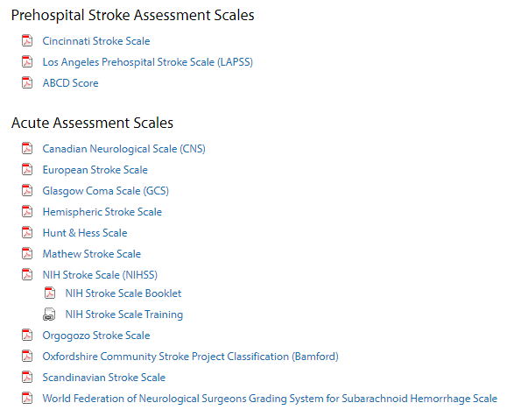
Take Stroke as an Example…
In the first 3 hours after a suspected cerebrovascular accident (CVA), non contrast head computerized tomography (CT) is the gold standard for diagnosis of acute hemorrhagic stroke

Slide 5
The Characteristics of Psychometric Assessments (cont.)
Weakness
The analysis of the results, especially on a large scale, demand practitioners and researchers to have a high level of statistical knowledge.
Under what scenarios, for what purposes, we should use psychometric instruments could be hard to decide.
As it is often self-reported, it often encounters reliability issues.
Socially desired answers (the poll…, work place satisfaction, etc)
We can address it by writing value neutral statements, and promising anonymity,
Subjects do not take it seriously (choose Cs from the beginning to the end)
Remedy: Two questions, one uses positive statement another worded as negative statement

Slide 6
Under what scenarios, for what purposes, we should use psychometric instruments
We will address the question from following perspectives:
Domain general v.s. Domain specific
Holistic v.s. Analytic
Psychological Disposition v.s. Psychological State
Actual situation v.s. Perception

Slide 7
Domain general v.s. Domain specific
Domain specificity is a theoretical position in cognitive science (especially modern cognitive development) that argues that many aspects of cognition are supported by specialized, presumably evolutionarily specified, learning devices.
i.e. (general) individuals who have a broad range of interests to novel subject matters (the people I think of include Galileo, DaVinci, Benjamin Flanklin…)
i.e. (specific) individuals who have a narrow but keen interest to certain things
You need to be clear whether you are testing a domain general construct (curiosity to everything) or a domain specific construct (curiosity to a subject/activity/genre)

Slide 8
Take teacher efficacy as an example
Self-efficacy is concerned with people's beliefs in their capabilities to exercise control over their own functioning and over events that affect their lives.
Four sources for efficacy (i) mastery experiences, (ii) vicarious experiences, (iii) social persuasion, and (iv) emotional states.
Domain general teacher efficacy refers to a judgment of his or her capabilities to bring about desired outcomes of student engagement and learning
Domain specific teacher efficacy refers to a judgment of his or her capabilities to achieve certain specific objectives in teaching

Slide 9
Take teacher efficacy as an example
Too often, we see administrators, policy makers or researchers use domain-general instruments (always the most famous instrument) to measure teacher efficacy in a specific domain
How efficacious they are to teach according to the new educational reform?
How efficacious they are to handle student disruptive behaviors?
How efficacious they are to incorporate content they learned from professional development in actual teaching?
How efficacious they are to gain students’ trust?
All these listed constructs need very specific instruments to capture what you want to measure.

Slide 10
Holistic v.s. Analytic
Holistic
Holistic analysis gives a single score or rating for an entire product, a trait or one performance based on overall impression
i.e. a feedback asking you about overall experiences (i.e. car service, 1 to 7 with 7 as highly satisfactory. The feedback is too general for you launch any action for improvement)
Analytic
Analytical analysis divides a product into essential dimensions (traits), and each dimension is judged separately. A separate score is given for each dimension or trait considered important for the assessed performance.
i.e. teaching evaluation (Space for improvement ☹ Tan has a bad rating; ☺ I can find out what to improve )

Slide 11
Psychological disposition v.s. Psychological state
Psychological State is …
A particular cognitive and emotional condition of the mind which can influence the physiological and behavioral responses to performance
i.e. the level of interest triggered when a specific topic is presented,
Have both individual and situational aspects
Could be temporary

Slide 12
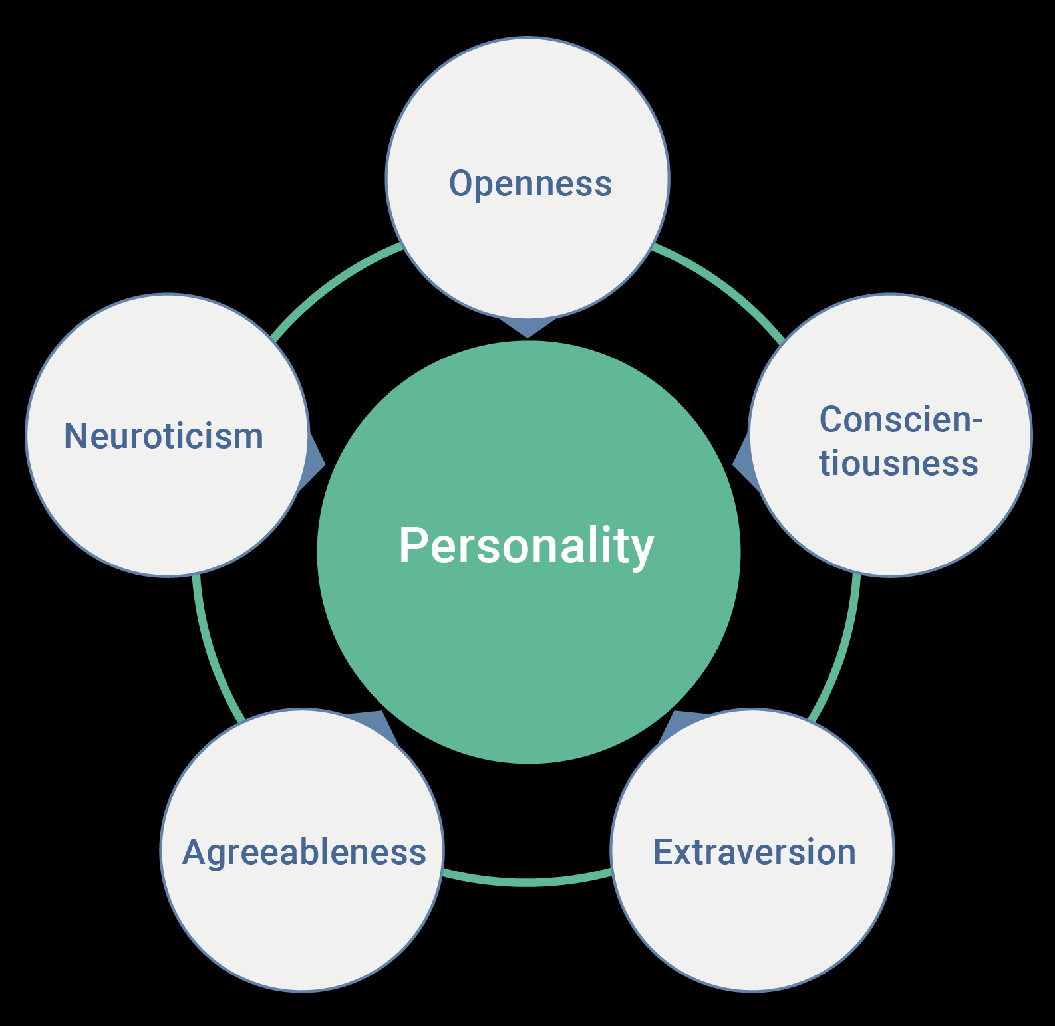
Psychological disposition v.s. Psychological state
Psychological disposition could be an individual’s ability, preference, values, beliefs, and traits.
Often based on a theory and embodied as a construct (see the right image)
i.e. being optimistic; grit; self-regulation, details-oriented
In other words, these are more stable yet long-lasting
In our field, what trait/disposition is valued?

Slide 13
Actual situation v.s. Perception
Actual situation: the Facts
Perception: an integration of the individual differences and the facts
We may be in the same environment, individual differences may lead us to have different perceptions for the environment.
WSSU is the best choice I can make
WSSU is beyond my expectation
WSSU is …
All the differences on perception may not reflect the reality, as we have different goals, attitudes, values, personality and motivation.

Slide 14
PE Teacher Motivation as an Example
Domain general v.s. Domain specific
Holistic v.s. Analytic
Psychological Disposition v.s. Psychological State
Actual situation v.s. Perception
By checking out the instrument I provide, tell me the characteristics of this instrument.

Slide 15
Six Components for PE Teacher Motivation
Three statements under each components, rank them based on your practices.
Assessment
I assess students’ learning process and the outcomes of their learning.
I assess students by comparing their performance with the standards.
I use attendance, participation and/or dress-out records as assessment.
Learning environment
Teaching objectives
Feedback to students
Pedagogical content
Pedagogical skill

Slide 16
PE Teacher motivation
Domain general v.s. Domain specific
Holistic v.s. Analytic
Psychological Disposition v.s. Psychological State
Actual situation v.s. Perception

Slide 17
How to adopt a developed instrument for your use?
Find out what is your assessment goal
Domain general v.s. Domain specific
Holistic v.s. Analytic
Psychological Disposition v.s. Psychological State
Actual situation v.s. Perception
Literature search
You want to go with the ones with many rounds of validation and reliability test in various populations
Make modification to your assessment goal
Tailor the instrument based on the characteristics of your subjects and environments

Slide 18
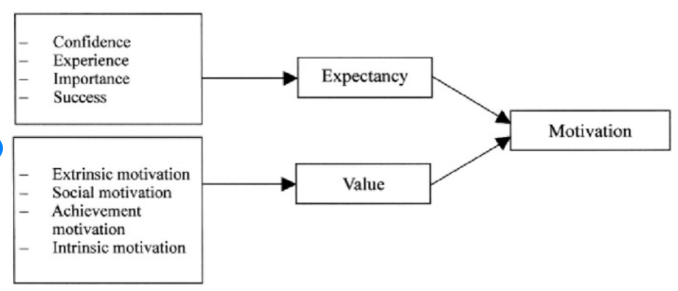
The project for PED 3322
Three components for the student survey we sent to our partner school:
Knowledge test on fitness and health
Students’ Expectancy and value for PE (for its construct see below)
Students’ Perceived Costs for PE

Slide 19
Knowledge, Value, Expectancy and Cost Items
Constructs | Items
Costs | I am not happy in PE when I receive negative comments or feedback from the teacher.
 | I do not work hard in PE because sweating is not comfortable.
 | I give less than my best effort in PE because I am working with someone I donot like to work with.
Expectancy | How good are you in physical education?
 | How well do you think you are in PE?
 | How well are you keeping yourself physically active in PE?
Value | How fun do you think your PE classes are?
 | How much do you like your PE classes?
 | How useful do you think the contents you learned in PE are?
Knowledge | The ones you created!

